Slide 1
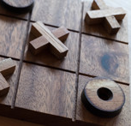
TIC TAC TOE
Simplicity at its finest…

Slide 2
Introduction
Name: ‘Tic Tac Toe’
Origin: Ancient Egypt (Around 1300 BC)
Recent Developments: Nothing major, but developers add more functionalities and increase the game experience.

Slide 3
Gameplay/Instructions
The game is played on a 3x3 grid (total of 9 squares).
Dual-player
The game is programmed to let the first player use the symbol ‘X’ while the other player is prompted the symbol ‘0’.
In order to win the game, one must get three identical marks (of that specific player) in the following ways:
Three identical marks vertically
Three identical marks horizontally
Three identical marks diagonally
If all the nine squares are filled without any formation of three identical marks of either ‘X’ or ‘0’ in the required orders, the contest is considered to be drawn.

Slide 4
Difficulties while developing
Initially, conceptualizing the design about how to develop the game using the C++ was tough.
When a specific player enters a value(1-9) as the input and the same input is given by the opponent, the mark in the same place in the structure overwrites. (Without prompting an error)
Assuming that in the 9th(final) move of the game, the game always draws. (Wrong – Due to players being able to win in any move of the game)
Another challenge was to make the code re-usable. As in, how to play the game again after the first game was entirely over.

Slide 5
Different approaches to the game
Apply a timer for a players’ turn.
Upgrade the user-interface UI (Preferably with C++ Builder) [Add labels, buttons, etc.]
Deploy a single-user (Human vs Computer) choice to play the game.
Add sound effects as players choose different options in the game.

Slide 6
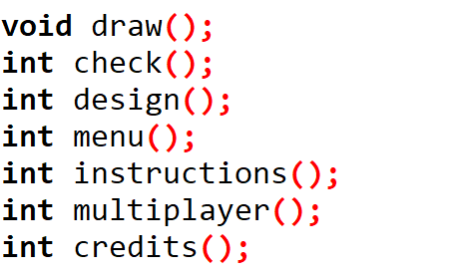
Functions USED

Slide 7
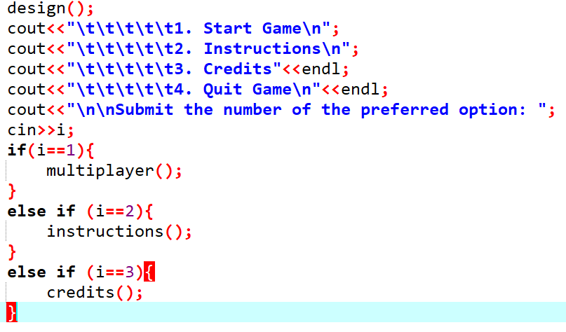
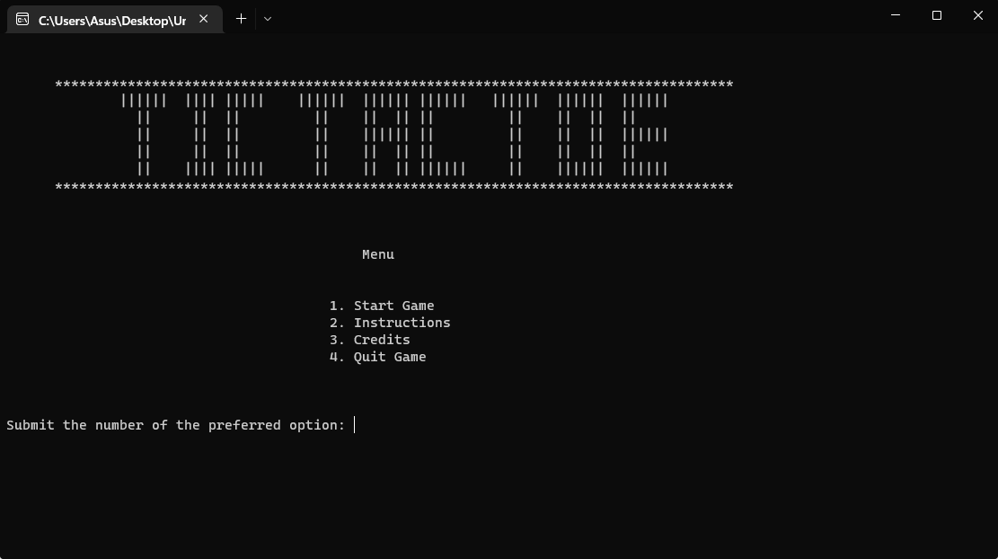
MANEUVERING through the PROGRAM (Main-Menu)

Slide 8
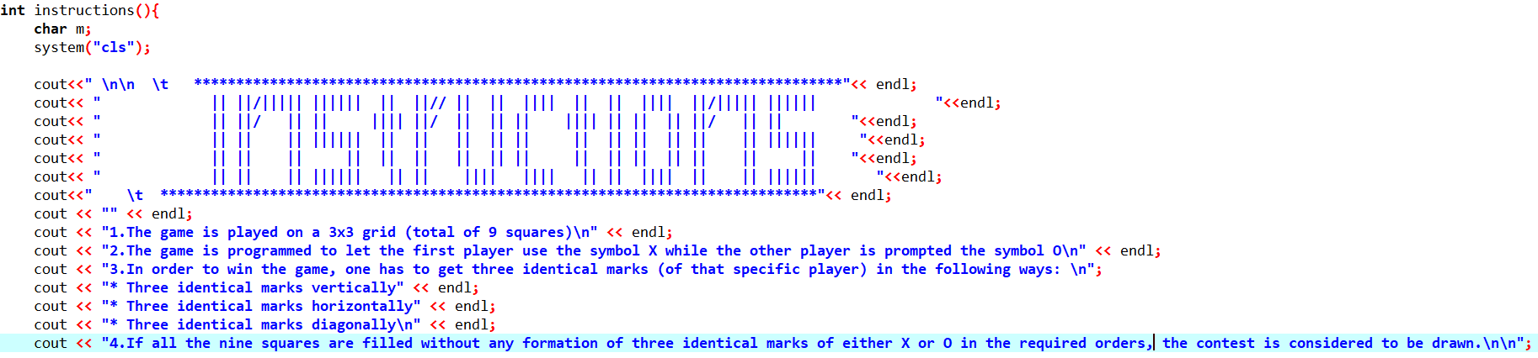
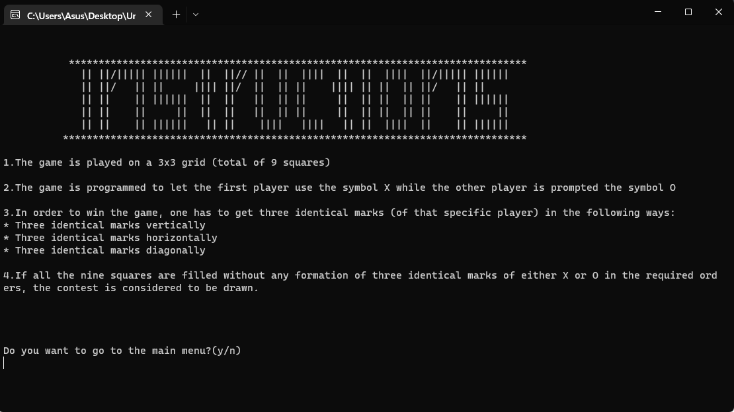
MANEUVERING through the PROGRAM (Instructions)

Slide 9
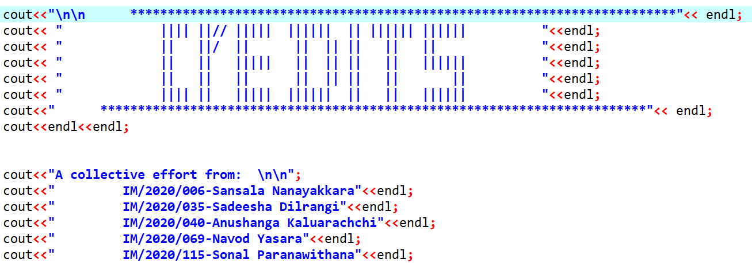
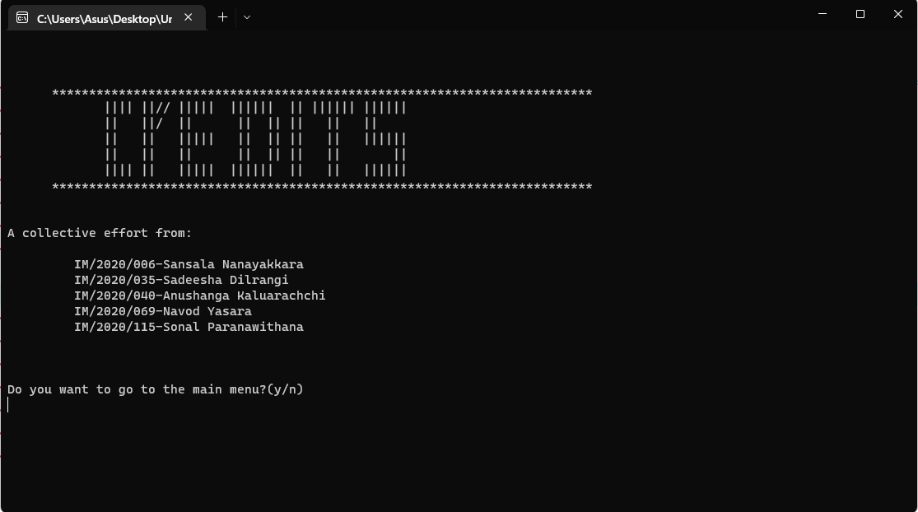
MANEUVERING through the PROGRAM (CREDITS)

Slide 10
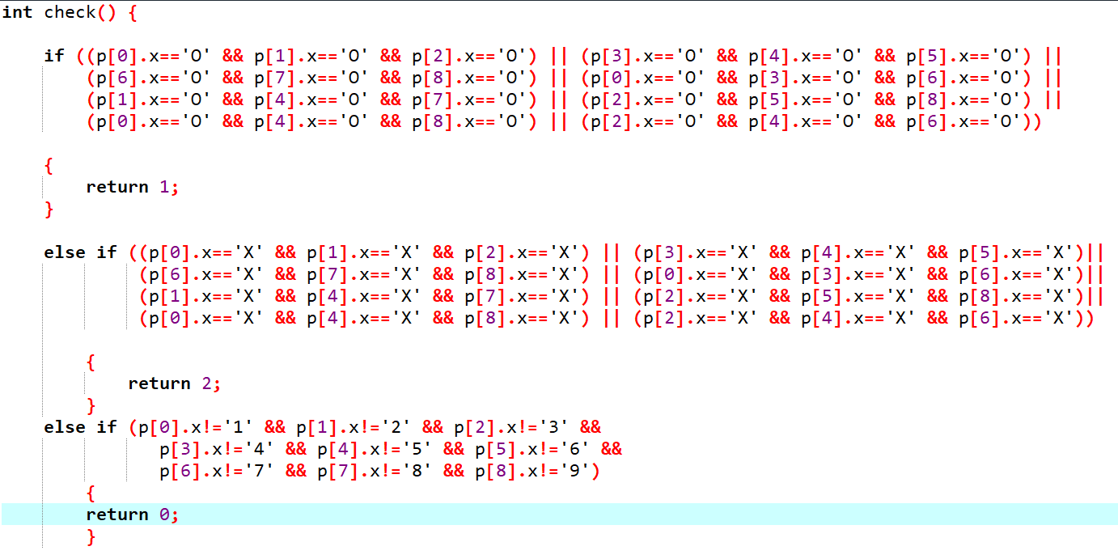
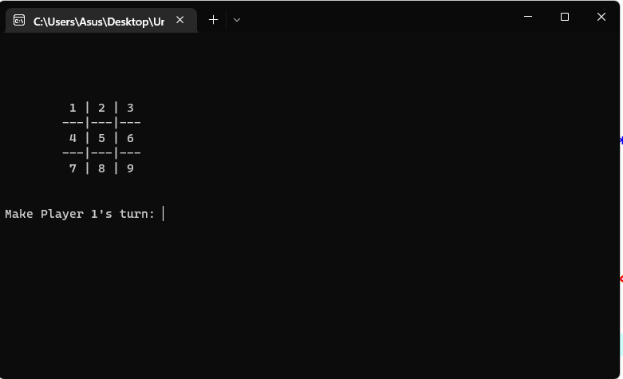
MANEUVERING through the PROGRAM (Playing the game)

Slide 11
Thank you for your attention Have a pleasant day!

